Slide 1
CSYE 6200
Final Project Presentation
CRM Model for a Bank
Made By :
Makarand Madhavi
Pranav Khismatrao
Yash Sah
Neha Rastogi
Shubhi Miradwal

Slide 2
Contents
Problem Statement
UML Class Diagram
Team Members and their Contributions
Technology Used
Applied Learning
Future Enhancements

Slide 3
Problem Statement
Developed a full stack Banking application with multiple functionalities for Customers and Relationship Managers with the help of Object Oriented Design Principles in Java.

Slide 4
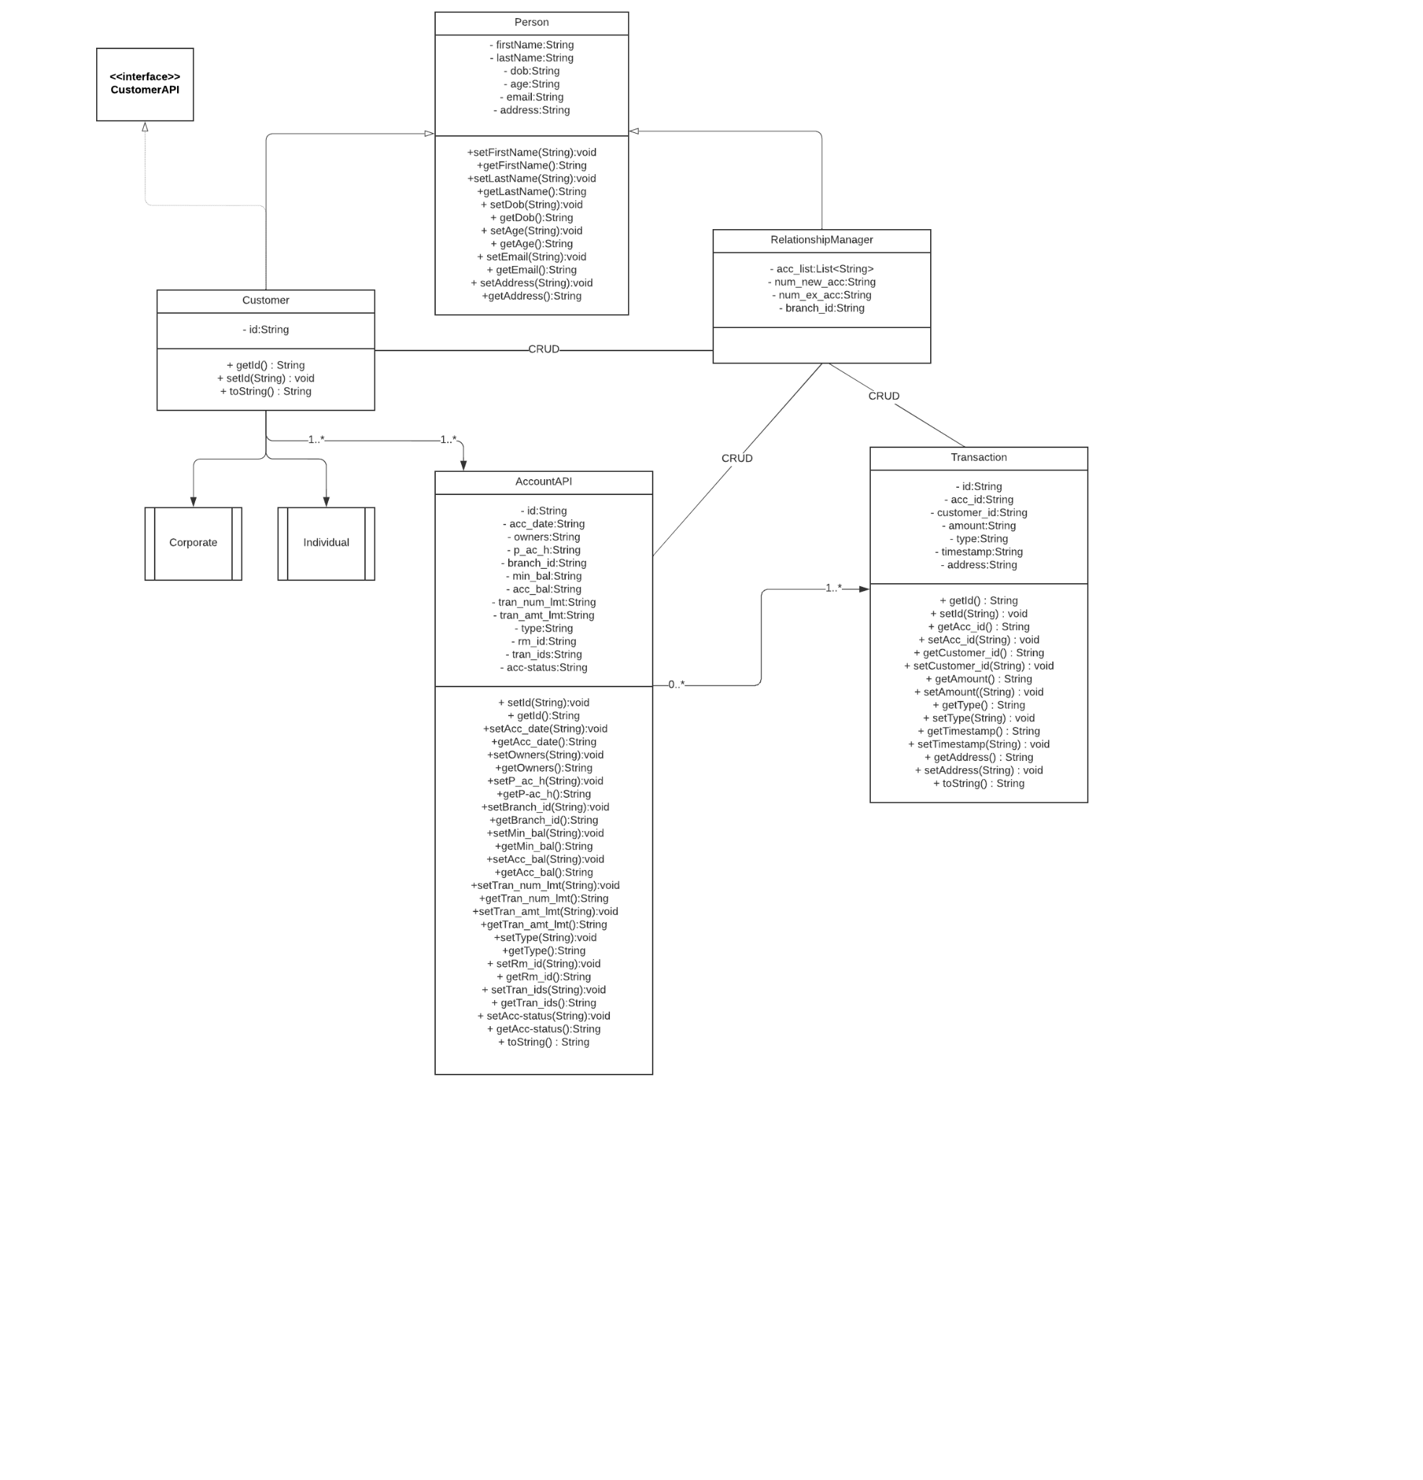
UML Diagram

Slide 5
Features
Enroll customers and accounts: capture data
– name, age
– address, phone
– GUI and CSV file input
Add transactions (for every account)
Generate monthly statement
Generate statement CSV
Assign Relationship managers to accounts according to rules
Assign RM/account/customer Groups to bank branch according to rules
Track annual employee review (Relationship Manager review)

Slide 6
Contributions by Each Team Member
Makarand: - Micronaut Rest API - singleton factory design pattern, Customer facing Website Integration
Pranav: - Implemented Account functionalities - creation and updation using Factories
Neha: - Customer Facing GUI creation , account statement creation by parsing transaction and writing csv files
Yash: - Implemented Reports functionalities using JavaFx. Added multiple CSS Styling using Java Fx. Creation of Customers using Java and Micronaut. Updation and testing of Data in Database.
Shubhi: -Implemented Transaction Functionality using JavaFX. Creation of Relationship Manager using Java and Micronaut.

Slide 7
Technology Used
Language , Frameworks and External Libraries:
Java 17
Micronaut
JavaFx
Aerospike Java Client
Lombok
Database
Aerospike - Running on a docker container
FrontEnd
JavaFx
HTML, CSS
Bootstrap

Slide 8
Lesson Learning
Outside Research Learning
Java Inheritance
Implemented API Design Pattern
Implemented Singleton Factory Design Pattern and GOF Factory
Sorting using Comparable
Writing CSV Files
Create GUI using JavaFx
External Libraries - Aerospike Java Client, AeroMapper object Mapper, Jackson json data binding
Micronaut MVC architecture - Singleton Controller-Service-Repository model
REST api Architecture

Slide 9
Future Enhancements
Add more account types including loan accounts
Add more customer types like individual-corporate,
UI can have more input features.

Slide 10
Thank you!

